Slide 1

TELCO CHURN PREDICTION MODEL A Model for Predicting Customer Retention in Telecom
Peerapat.t For project’s material please visit : github.com/peerapat-t

Slide 2

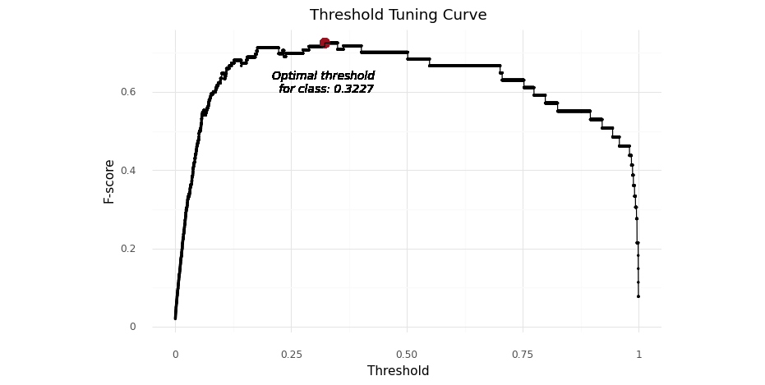
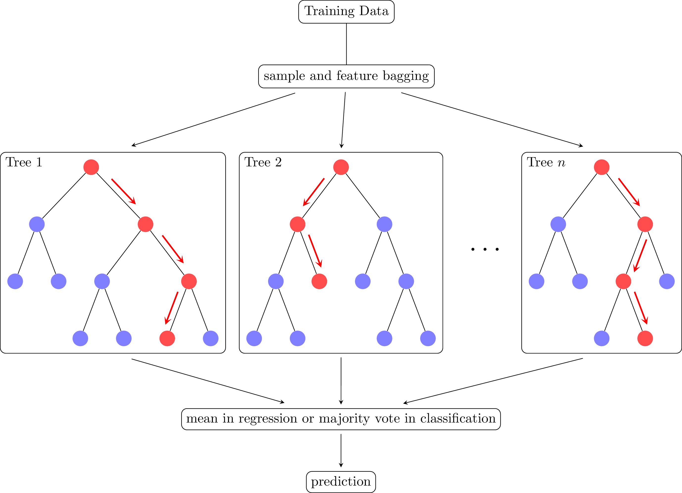


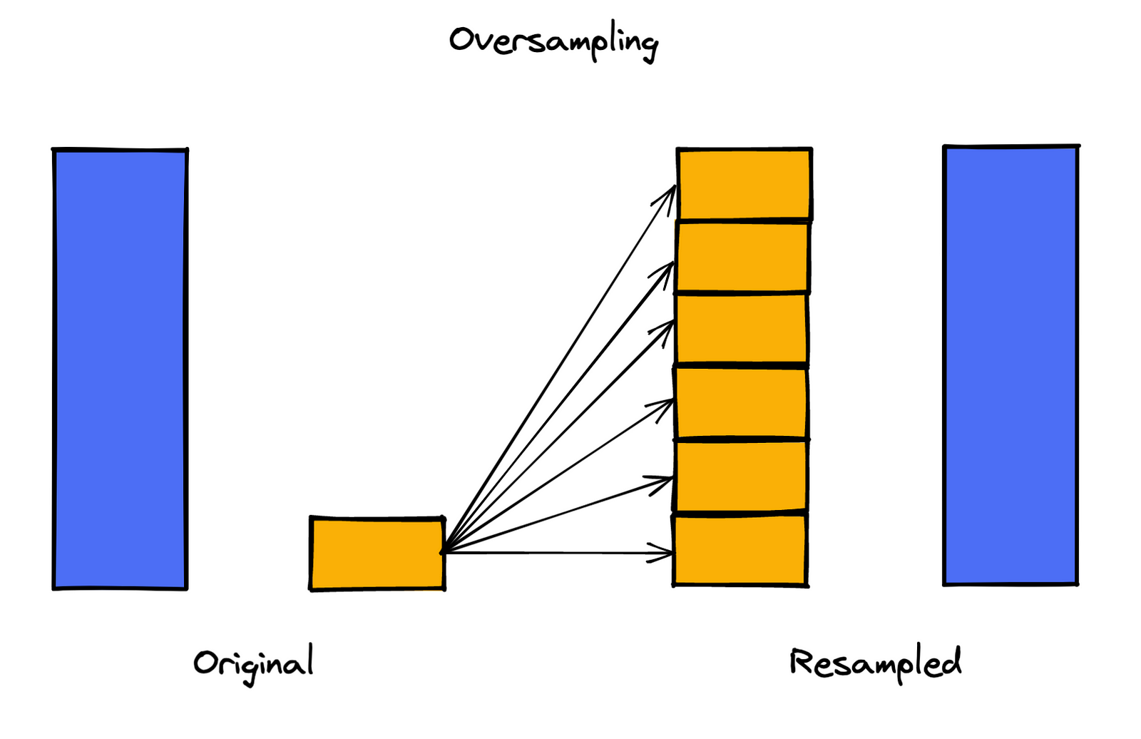


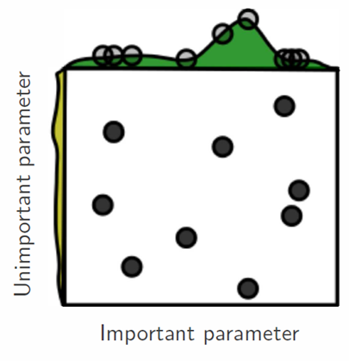

TELCO CHURN PREDICTION MODEL
A Model for Predicting Customer Retention in Telecom
Problem context
Retaining a customer is generally more cost-effective than acquiring a new one, as demonstrated by a Bain & Company study.
The study revealed that acquiring a new customer can be 5 to 7 times more expensive than retaining an existing one.
Existing customers, being familiar with your product or service, tend to exhibit greater loyalty and are more inclined to maintain their business relationship with you.
Challenges
Imbalanced dataset
Metrics for measurement
Threshold optimization
Tools
Methods
Business impact
Random forest
The model improved revenue by 164.24% compared to the 'do nothing' program and by 44.51% compared to the 'retain all' program.
Threshold tuning
Random forest
Resampling (SMOTE, ADASYN, Under sampling)
Random forest
Shapley
Randomized search
TELCO CHURN PREDICTION MODEL

Slide 3
TABLE OF CONTENT
Problem Statement
Business Value
Methodology
Results
Conclusions/Recommendations
Future Work
Appendix
About me
TELCO CHURN PREDICTION MODEL

Slide 4
1. PROBLEM STATEMENT
The cost of retaining a customer is typically much lower than the cost of acquiring a new customer.
For example, a study by Bain & Company found that it costs 5 to 7 times more to acquire a new customer than it does to retain an existing customer.
This is because existing customers are already familiar with your product or service and they are more likely to continue doing business with you.
TELCO CHURN PREDICTION MODEL

Slide 5
2. BUSINESS VALUE
A churn prediction model in a telco company provides substantial business value by forecasting which customers are likely to leave the service.
This predictive capability allows the company to take proactive measures to retain customers, such as offering personalized incentives or addressing their concerns.
By reducing churn, the company can achieve cost savings associated with customer acquisition, preserve existing revenue streams, and enhance overall customer satisfaction.
TELCO CHURN PREDICTION MODEL

Slide 6
3. METHODOLOGY
Do nothing
Business not take any action to retain customers.
Retain all customers
Business take action to retain every customer.
Use a churn prediction model
Business use churn prediction model to predict the probability of churning and use this score to decide whether a customer will churn.
Churn prediction can help businesses identify customers who are at risk of leaving.
This allows businesses to take action to retain those customers, such as offering them discounts or special promotions.
Option | Cost | Effectiveness
Do nothing | Least expensive | Least effective
Retain all customers | Most expensive | Most effective
Use a churn prediction model | More cost-effective than retaining all customers | More effective than doing nothing
TELCO CHURN PREDICTION MODEL

Slide 7
3. METHODOLOGY
Target
There are 7,043 customers in the dataset, including churn and not-churn customers.
Churn customers are those who have unsubscribed within the last month.
Customer account information: This includes how long they've been a customer, contract, payment method, paperless billing, monthly charges, and total charges.
Demographic info about customers: This includes gender, age range, and if they have partners and dependents.
Features
The dataset contains 22 features, which can be categorized into 3 groups:
Services that each customer has signed up for: This includes phone, multiple lines, internet, online security, online backup, device protection, tech support, and streaming TV and movies.
Universe: 7,032 customers who still active in this month
Unsubscribe (target 1)
Not unsubscribe (target 0)
This month
Next month
TELCO CHURN PREDICTION MODEL

Slide 8
4. RESULT
Model result
Method | Total (Test) | Actual churn | Overspend (FP) | Save (TP) | Gains (or Loss)
Do nothing | 1,409 | 373 | 0 | 0 | -186,500
Retain all | 1,409 | 373 | 1,036 | 373 | 82,900
Churn prediction model | 1,409 | 373 | 253 | 302 | 119,800
* These calculations are based on the assumption that the cost of promotion is 100, the cost of loss is 500, and the savings per customer is 500.
Utilizing data from the test set involving approximately 1,409 customers, the churn prediction model yielded a gain of 164.24% when compared to the 'do nothing' program, and 44.51% when compared to the 'retain all' program.
TELCO CHURN PREDICTION MODEL

Slide 9
4. RESULT
Feature importance
Rank | Features | Sign | Meaning
1 | Contract | + | Customers on contract or top-up plans are more likely to churn, possibly due to the ease of changing numbers for top-up customers.
2 | Tenure | + | Long-time customers have a higher churn probability, potentially due to elderly individuals reducing phone usage to cut expenses.
3 | Monthly charges | - | Customers paying lower charges are more likely to churn, influenced by industry trends towards appealing, low-priced packages from other operators.
4 | Internet service | - | Customers without internet in their package are at a higher churn risk, as competitors offer inclusive internet services, reflecting its growing importance.
5 | Payment method (electronic check) | - | Non-users of electronic payment for bills are more likely to churn, possibly due to the inconvenience of payment, prompting a switch to other providers.
TELCO CHURN PREDICTION MODEL

Slide 10
5. CONCLUSIONS/RECOMMENDATIONS
Conclusion
The churn prediction model, based on the analysis of a test set comprising around 1,409 customers, has demonstrated its effectiveness in reducing customer churn significantly.
When compared to the 'do nothing' program, which involves no proactive retention efforts, the model achieved a remarkable gain of 164.24%. Additionally, in comparison to the 'retain all' program, which indiscriminately attempts to retain all customers, the model still outperformed with a gain of 44.51%. These results underscore the value of predictive modeling in identifying and mitigating customer churn.
Recommendation
Implement the churn prediction model as a core part of your customer retention strategy to identify at-risk customers.
Develop personalized retention strategies based on the model's insights to optimize resource allocation.
Regularly monitor and improve the churn prediction model to ensure its accuracy and effectiveness over time.
TELCO CHURN PREDICTION MODEL

Slide 11
6. FUTURE WORK
Improve model performance by creating more features and performing feature engineering.
Experiment with different machine learning models, such as SVC and deep learning.
Tune hyperparameters using sequential search techniques, such as Optuna.
Segment customers using clustering and retain them with personalized promotions.
TELCO CHURN PREDICTION MODEL

Slide 12

END OF PRESENTATION
TELCO CHURN PREDICTION MODEL

Slide 13
7. APPENDIX
Technique
Step | Topic | Cost
1 | Dataset | Split the data into train, test, and validation sets. Use the train set to train the model, the validation set to tune the threshold, and the test set to evaluate the model.
2 | Normalized | Use Min-Max scaling to normalize the data.
3 | Resampling | Try oversampling (SMOTE) and undersampling (random undersampling).
4 | Model | Try random forest, LightGBM, and XGBoost.
5 | Hyperparameter tuning | Use RandomizedCV to find the best hyperparameters for each model.
6 | Threshold tuning | Use cost-sensitive learning to tune the threshold. Assign a cost of 5 times more to acquiring new customers than to retaining existing customers.
7 | Interpreting | Use SHAP values.
TELCO CHURN PREDICTION MODEL

Slide 14
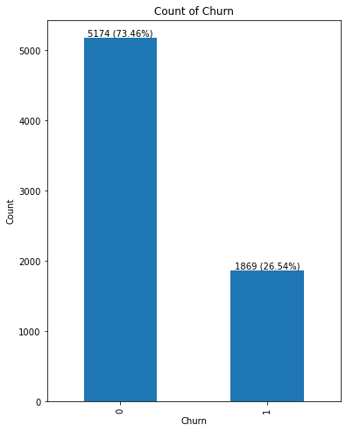
7. APPENDIX
Exploratory data analysis (EDA)
If we look at the target distribution, There are only 27% of churn customers that the data is imbalanced.
Resampling method or threshold tuning should be applied to handle this problem.
Metrics like accuracy can be misleading and ineffective. Instead, it is essential to explore alternative evaluation measures, such as precision, recall, F1-score, or AUC-ROC.
TELCO CHURN PREDICTION MODEL

Slide 15
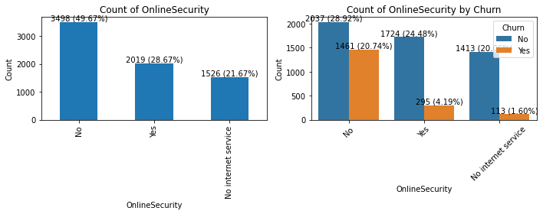

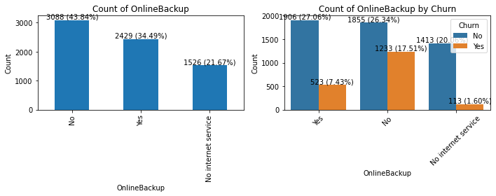
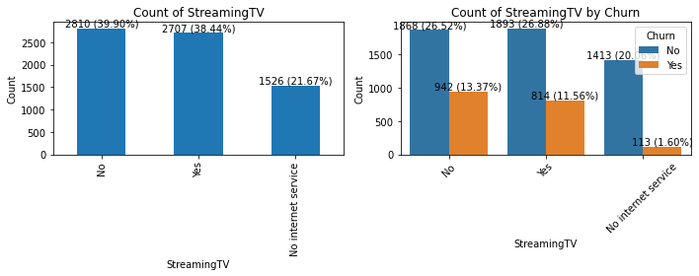
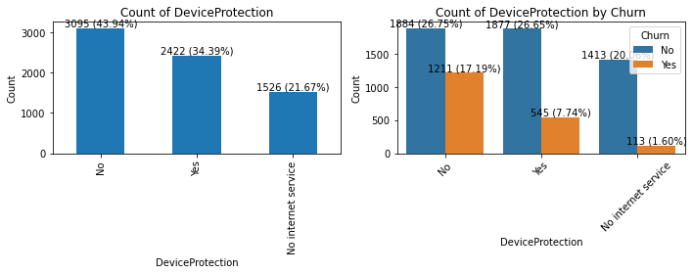

7. APPENDIX
Exploratory data analysis (EDA)
The phrase "No internet service" appears in 6 variables, all with the same frequency of 1,526.
TELCO CHURN PREDICTION MODEL

Slide 16
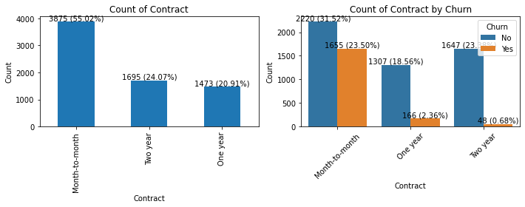
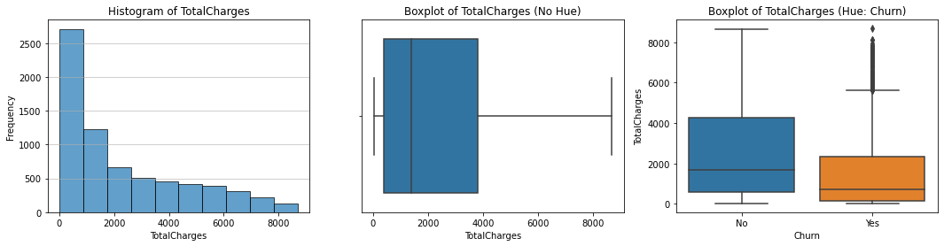
7. APPENDIX
Exploratory data analysis (EDA)
Can represent the "Contract" variable as an ordinal variable with values 0, 1, and 2.
0, 1, 2
The distribution of 'TotalCharges' is right-skewed. Use the median to replace missing values instead of the mean.
TELCO CHURN PREDICTION MODEL

Slide 17
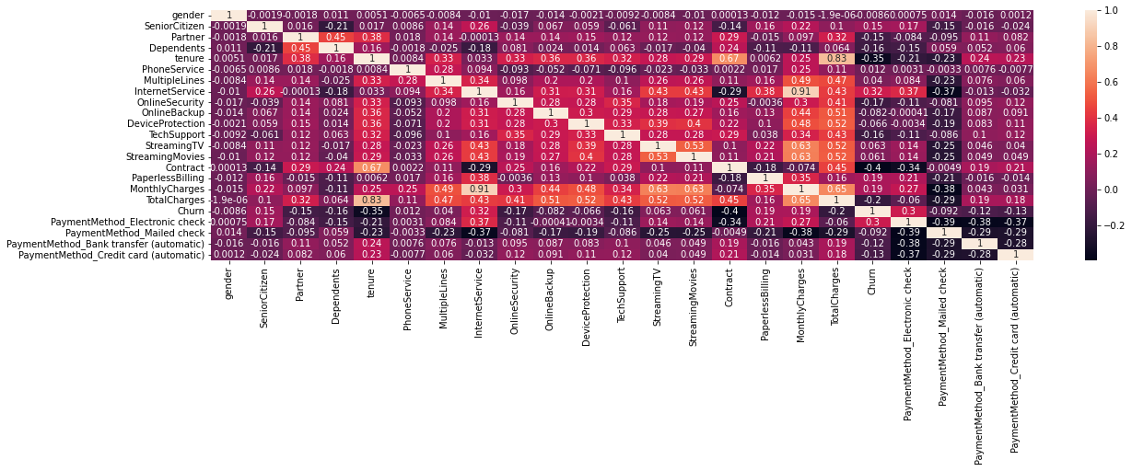
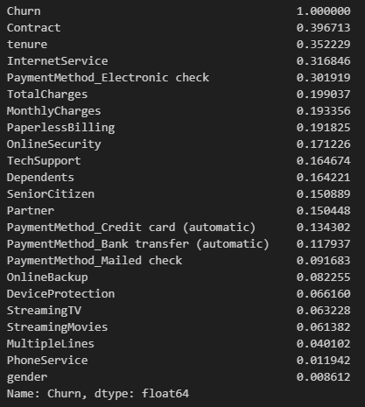
7. APPENDIX
Exploratory data analysis (EDA)
4 features, including contract, tenure, internet service, and electronic payment method, exhibit a high correlation (greater than 0.3 in absolute terms) with the target variable.
TELCO CHURN PREDICTION MODEL

Slide 18
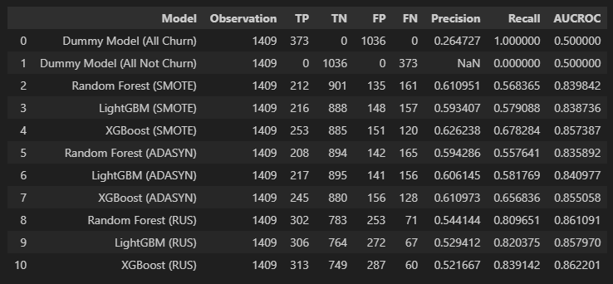
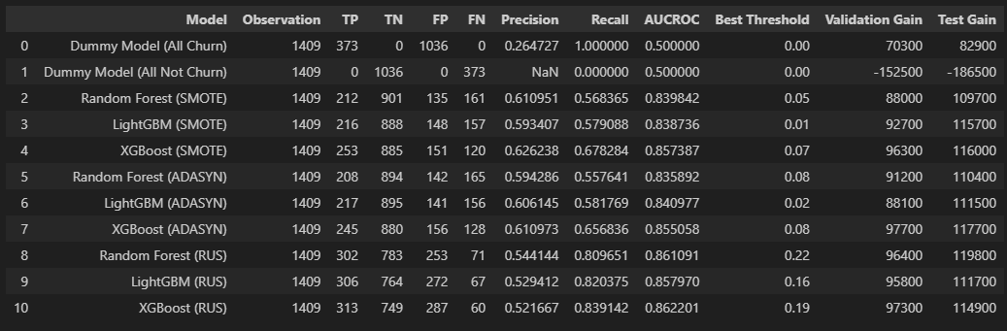
7. APPENDIX
Model evaluation
Before performing threshold tuning, XGBoost (RUS) seems good because it has a highest AUCROC.
However, prior to that, Random forest (RUS) is the better model as it achieves maximum gains.
Ultimately, for the final decision, we choose Random forest (RUS) to deploy.
TELCO CHURN PREDICTION MODEL

Slide 19
7. APPENDIX
Threshold
1.00
Churn
0.22
Not churn
0.00
TELCO CHURN PREDICTION MODEL

Slide 20
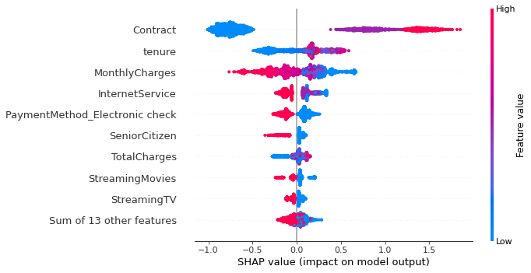
7. APPENDIX
SHAP
Features | Sign | Meaning
Contract | + | Customers on contract or top-up plans are more likely to churn, possibly due to the ease of changing numbers for top-up customers.
Tenure | + | Long-time customers have a higher churn probability, potentially due to elderly individuals reducing phone usage to cut expenses.
Monthly charges | - | Customers paying lower charges are more likely to churn, influenced by industry trends towards appealing, low-priced packages from other operators.
Internet service | - | Customers without internet in their package are at a higher churn risk, as competitors offer inclusive internet services, reflecting its growing importance.
Payment method (electronic check) | - | Non-users of electronic payment for bills are more likely to churn, possibly due to the inconvenience of payment, prompting a switch to other providers.
TELCO CHURN PREDICTION MODEL

Slide 21
7. APPENDIX
Reference
https://medium.com/@stephen.blount99/putting-a-price-on-customer-churn-38a184e530b8
https://www.kaggle.com/datasets/blastchar/telco-customer-churn/data
https://www.kaggle.com/code/bandiatindra/telecom-churn-prediction
https://machinelearningmastery.com/smote-oversampling-for-imbalanced-classification/
TELCO CHURN PREDICTION MODEL

Slide 22
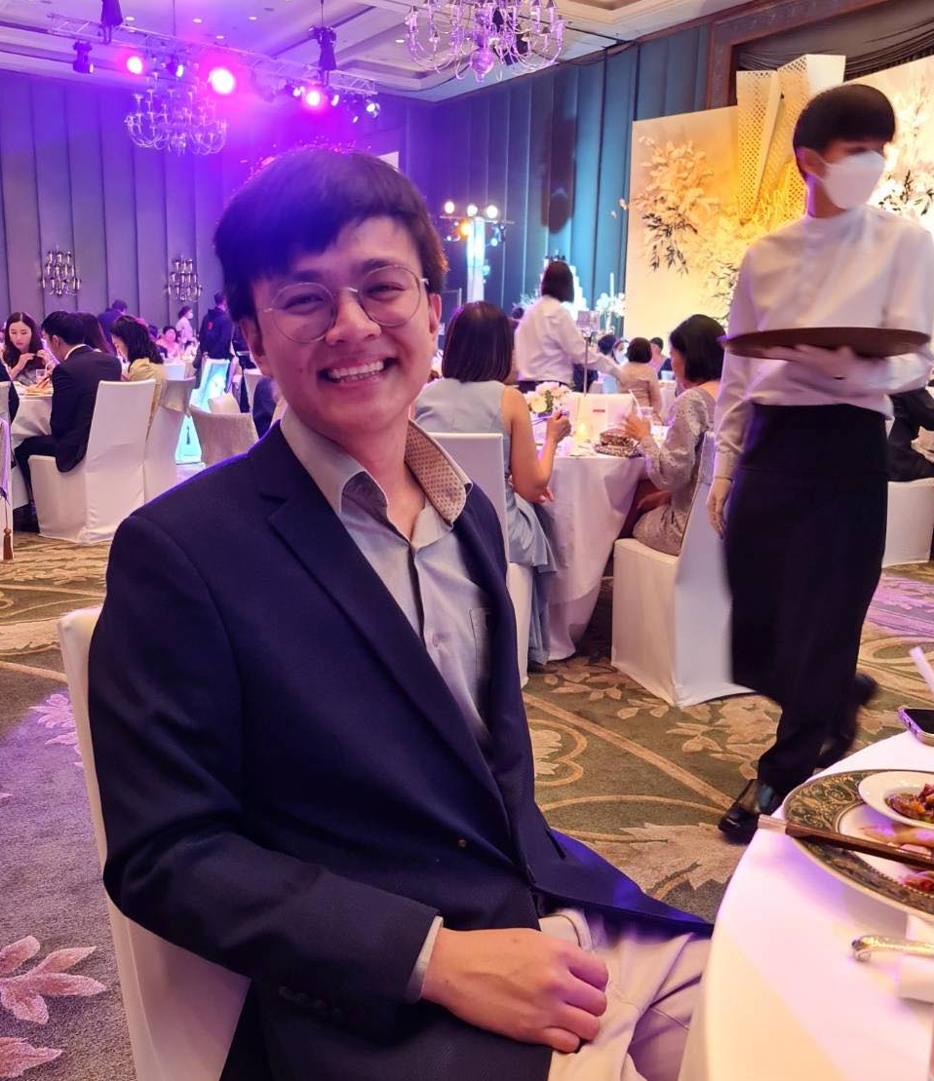

8. ABOUT ME
Peerapat Tancharoen holds a Bachelor's degree in Economics from Srinakharinwirot University, graduating with first honors and a GPA of 3.67. He also earned a Master's degree in Economics from Thammasat University, achieving a GPA of 3.98.
Contact me on
linkedin.com/in/peerapat-tancharoen-664759220/
peerapat.tcr@gmail.com
TELCO CHURN PREDICTION MODEL

